Slide 1

Air Quality Monitoring System Using Sensor
A Modular Real-Time Approach to Environmental Sensing
A technical presentation detailing the integration and functionality of key sensors and the ESP32 microcontroller for comprehensive air quality assessment.

Slide 2

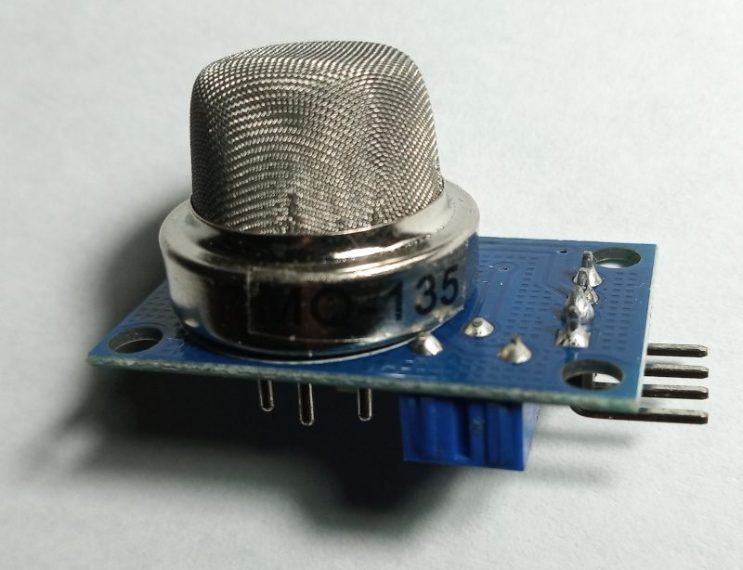

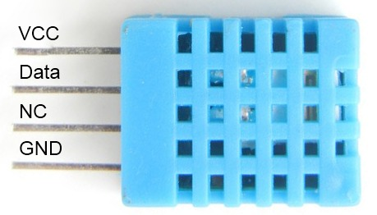

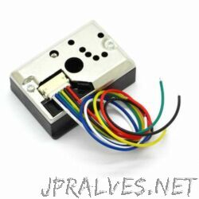

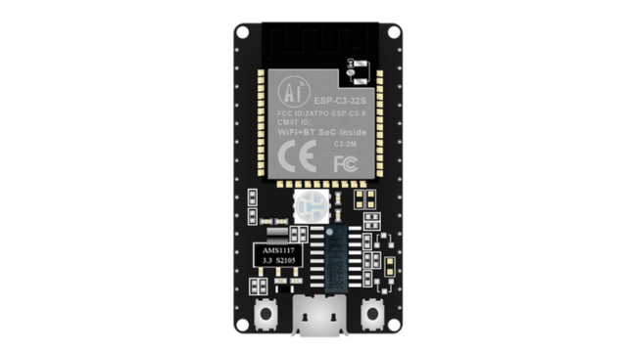
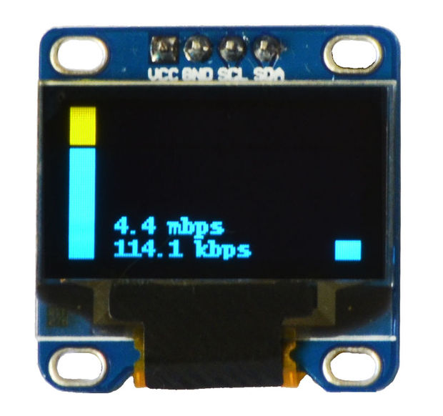

Core Components Overview
This air quality monitoring system relies on a suite of specialised sensors, the powerful ESP32 microcontroller, and a clear visual interface to deliver accurate environmental data.
MQ135 Gas Sensor
Measures various harmful gases and volatile organic compounds (VOCs).
DHT11 Sensor
Captures essential environmental factors: temperature and relative humidity.
This Photo by Unknown Author is licensed under CC BY
GP2Y1010AU0F Sensor
This Photo by Unknown Author is licensed under CC BY-SA
Focuses on measuring airborne particulate matter (dust) concentration.
This Photo by Unknown Author is licensed under CC BY-SA
ESP32 & OLED Display
This Photo by Unknown Author is licensed under CC BY-NC-ND
The brain for processing data and the visual interface for real-time results.
This Photo by Unknown Author is licensed under CC BY-SA

Slide 3
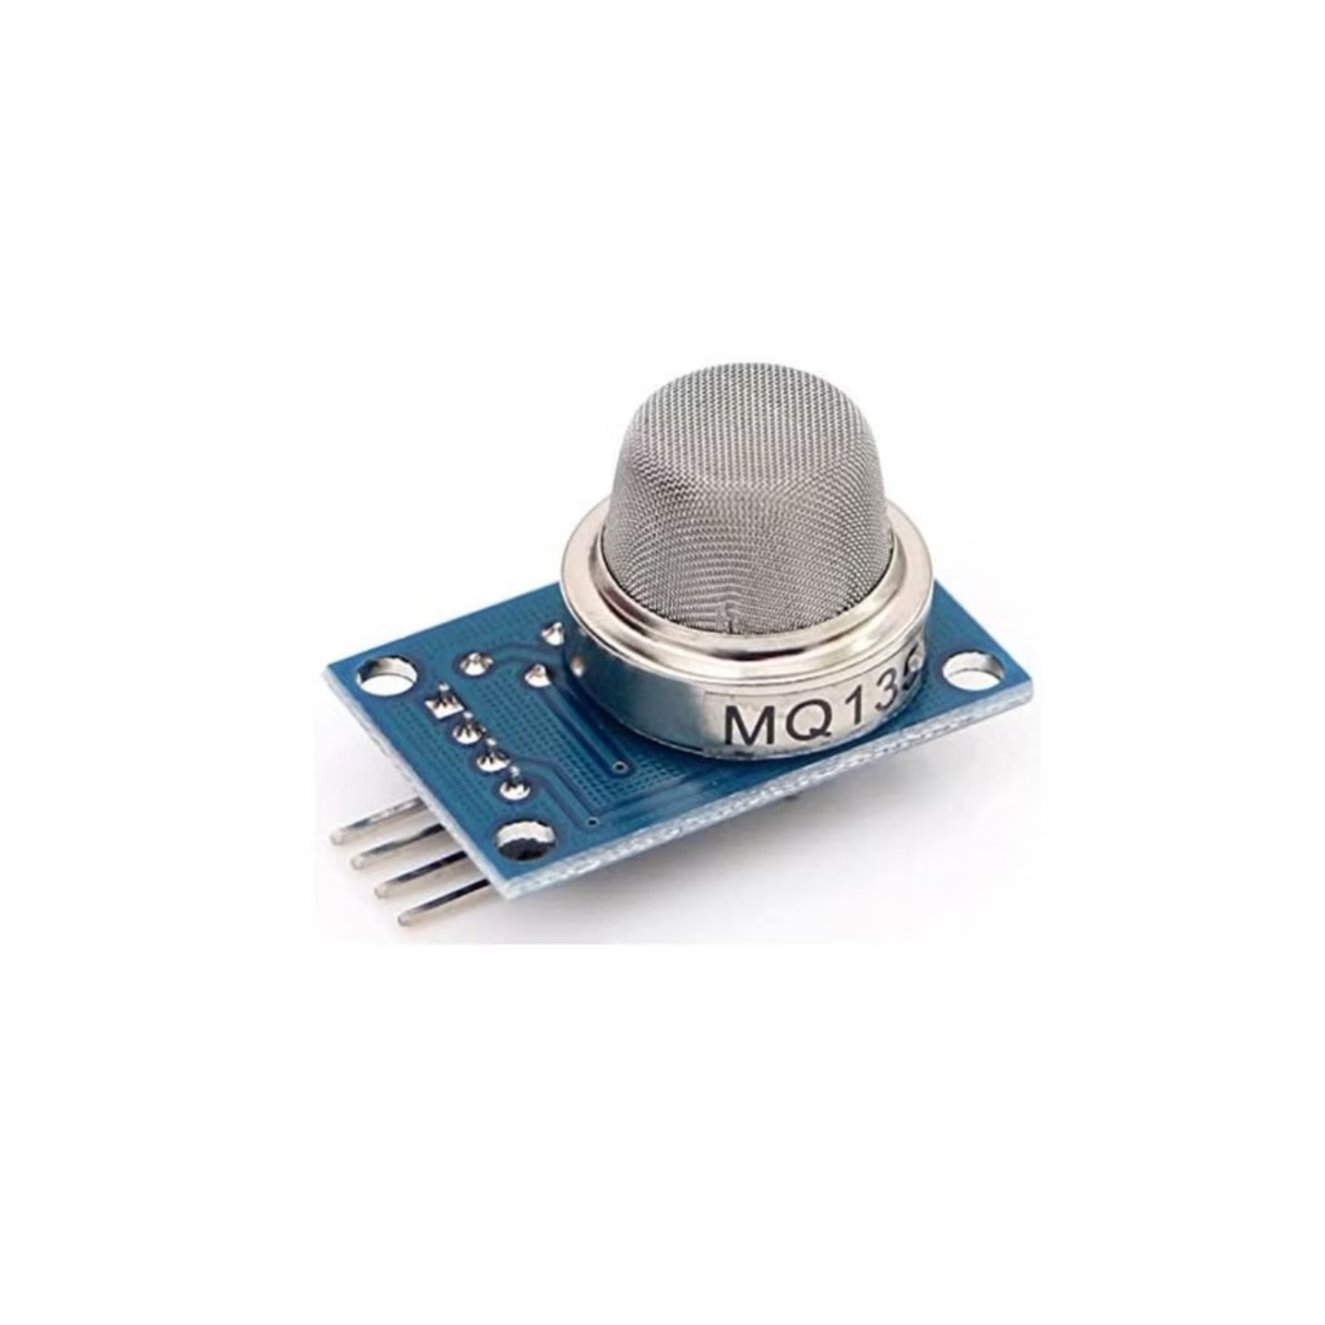
MQ135 Gas Sensor: Detecting Harmful Air Pollutants
The MQ135 is crucial for assessing overall air cleanliness by identifying a wide spectrum of common indoor and outdoor air pollutants.
Measures air quality by detecting gases like NH3, NOx, alcohol, benzene, smoke, and CO2.
It uses a sensitive tin dioxide (SnO2) semiconductor element to change resistance based on gas concentration.
Outputs analog signals directly proportional to pollutant levels, enabling real-time monitoring.
Ideal for detecting toxic gases and providing a general index of air pollution.

Slide 4
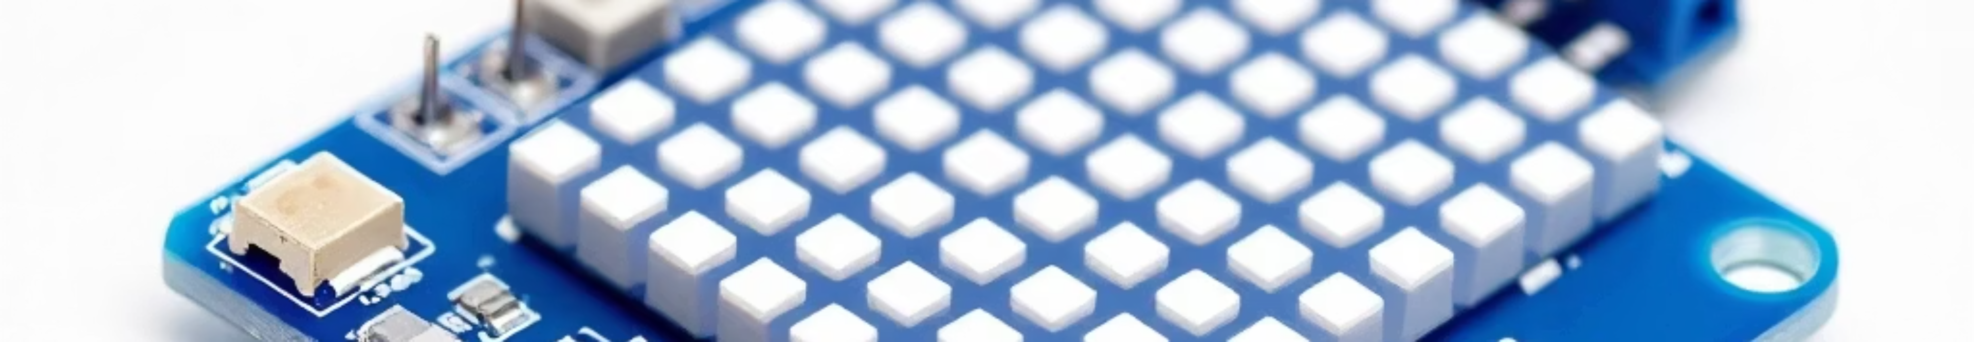
DHT11 Sensor: Monitoring Temperature and Humidity
Environmental conditions significantly influence pollutant behaviour. The DHT11 provides essential baseline data for accurate air quality interpretation.
Digital Readings
Sensing Mechanism
Provides discrete, calibrated digital readings for ambient temperature and relative humidity.
Employs a capacitive humidity sensor and a thermistor for reliable, accurate environmental measurement.
Air Quality Correlation
Microcontroller Interface
Essential for correlating pollutant data with external factors, as humidity affects the lifecycle of many contaminants.
Features a simple single-wire digital interface, making it easy to integrate with the ESP32.

Slide 5

GP2Y1010AU0F Sensor: Measuring Particulate Matter
Particulate matter (PM) is a key indicator of poor air quality, especially regarding respiratory health.
This is an optical dust sensor designed to detect airborne particles, including PM2.5 and PM10.
It operates by detecting the light scattered by particles when illuminated by an infrared LED.
This Photo by Unknown Author is licensed under CC BY-NC-ND
The analog output voltage is directly proportional to the density of the particulate matter in the air.
Critical for assessing pollution from dust, smoke, pollen, and other fine airborne contaminants.
The GP2Y1010AU0F is highly effective in monitoring the health-critical density of dust particles.

Slide 6




ESP32 Microcontroller: The System’s Brain
The ESP32 acts as the central processing unit, orchestrating data acquisition, processing, and output management.
Powerful Processing
Integrated Connectivity
Data Acquisition
Features a dual-core processor capable of handling complex sensor data streams simultaneously.
Built-in Wi-Fi and Bluetooth capabilities enable Internet of Things (IoT) functionality and remote monitoring.
Reads both analog (MQ135, GP2Y1010AU0F) and digital (DHT11) sensor inputs efficiently.

Slide 7
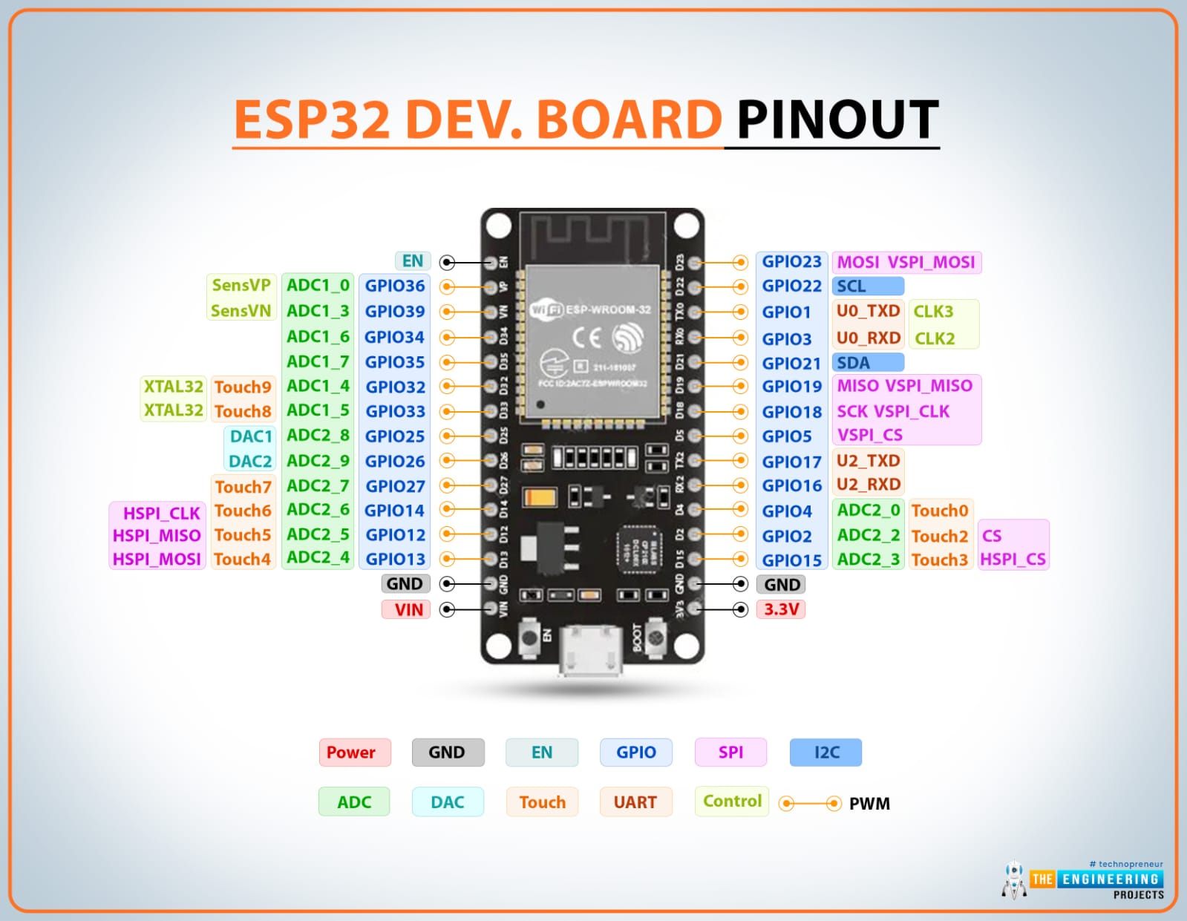
MQ135 Sensor | Analog | GPIO34 | Air Quality (Gas) Reading
Dust Sensor | Analog | GPIO35 | Dust/Particulate Measurement
OLED Display (SSD1306) | I2C (SDA) | GPIO21 | Data Line
 | I2C (SCL) | GPIO22 | Clock Line
Power | VCC, GND | 3V3 / GND | Common Power Supply

Slide 8
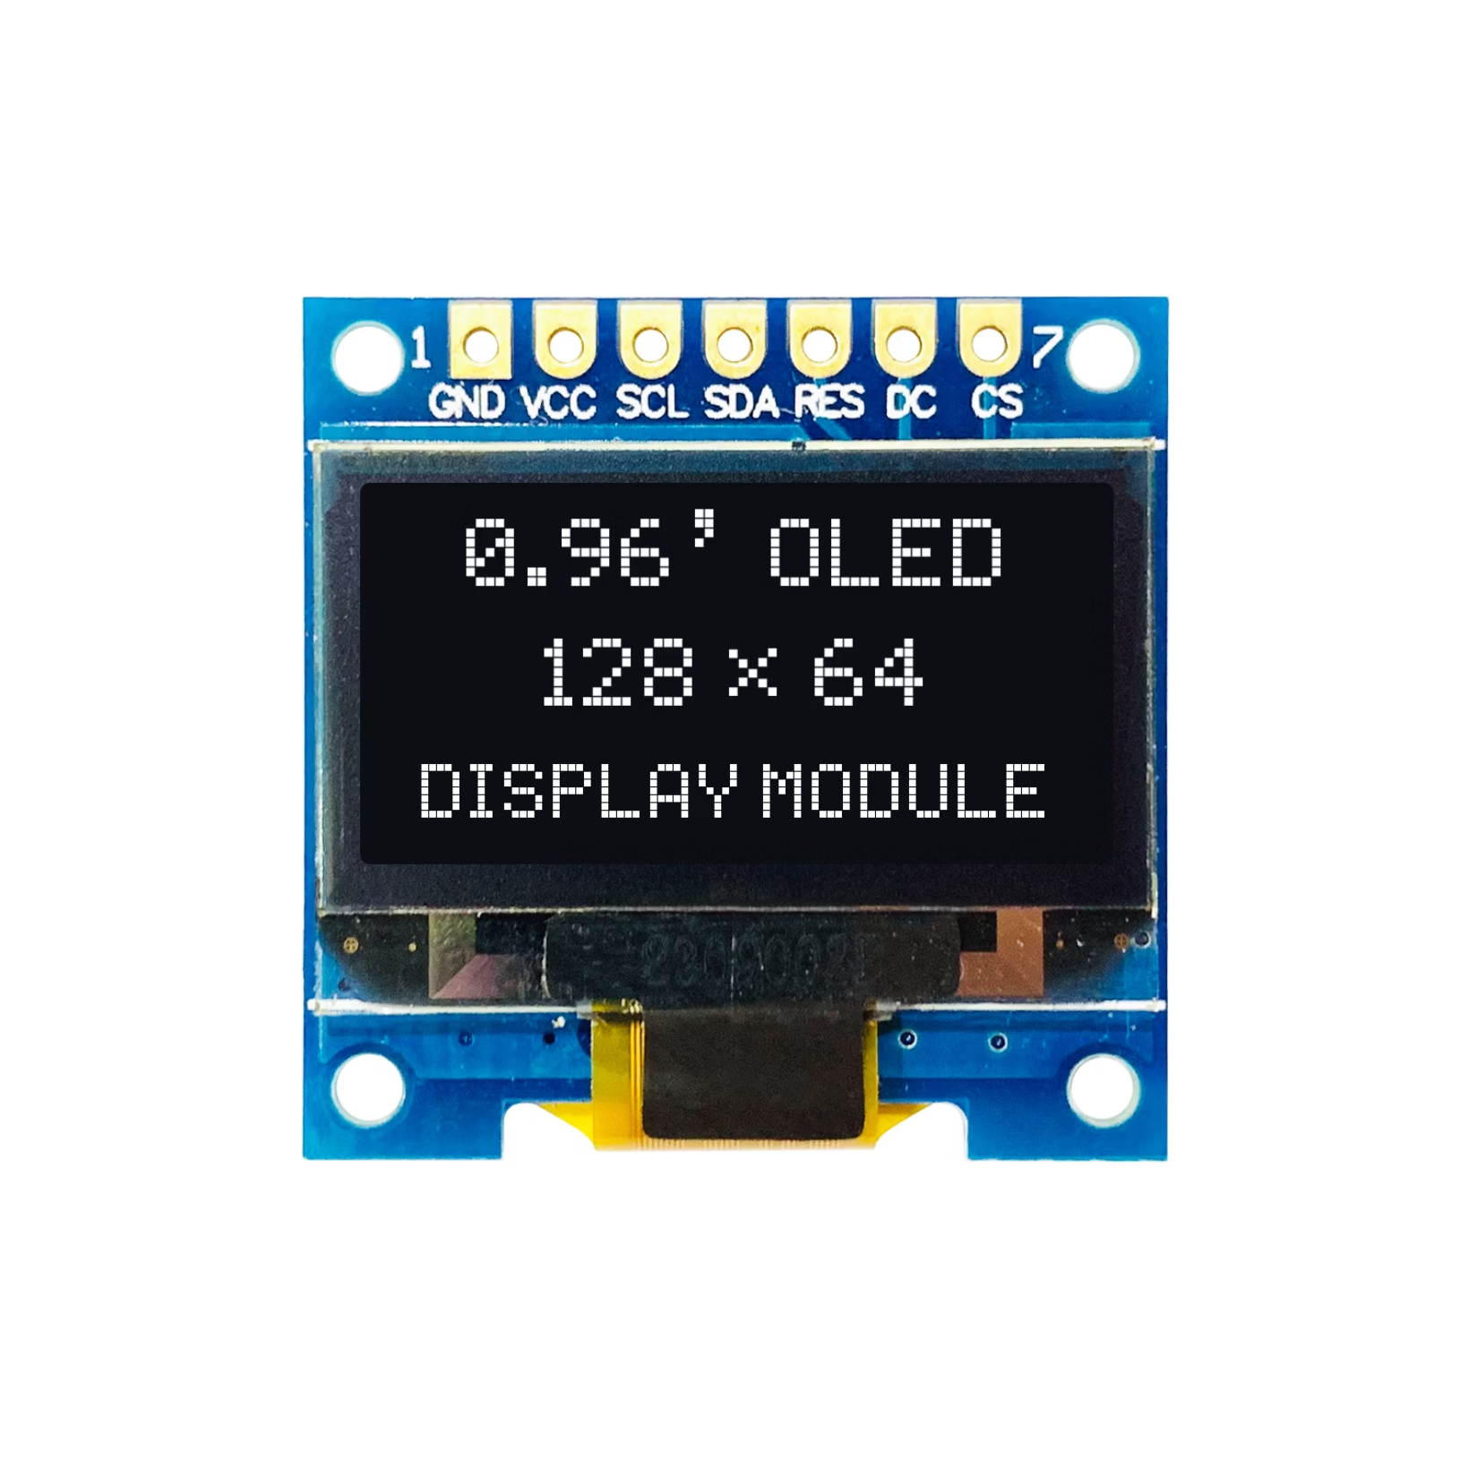
0.96" OLED Display: Visualising Air Quality Data
The OLED display provides users with immediate, clear, and high-contrast feedback on current environmental conditions.
It is a compact, high-contrast screen, ensuring readings are clear even in low light.
Displays comprehensive data: temperature, humidity, gas concentration (e.g., as an AQI value), and PM levels.
Utilises the efficient I2C interface for simple connection and minimal wiring with the ESP32.
Low power consumption makes it ideal for continuously running environmental monitoring projects.

Slide 9
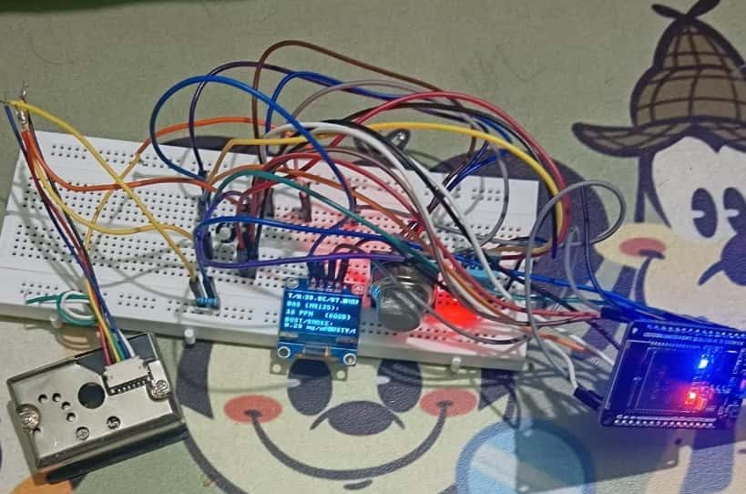
Breadboard Integration: Bringing It All Together
The breadboard setup serves as a flexible prototype environment, connecting all components in a cohesive, functional unit.
Sensor Placement
1
MQ135, DHT11, and GP2Y1010AU0F are strategically placed and wired for power and data transmission.
Interfacing
2
Sensors are connected to the ESP32’s designated analog and digital input/output pins.
OLED Connection
3
The OLED display connects using the I2C protocol, simplifying the communication bus.
Prototype Flexibility
4
The modular breadboard allows for easy testing, calibration adjustments, and future sensor expansion.

Slide 10
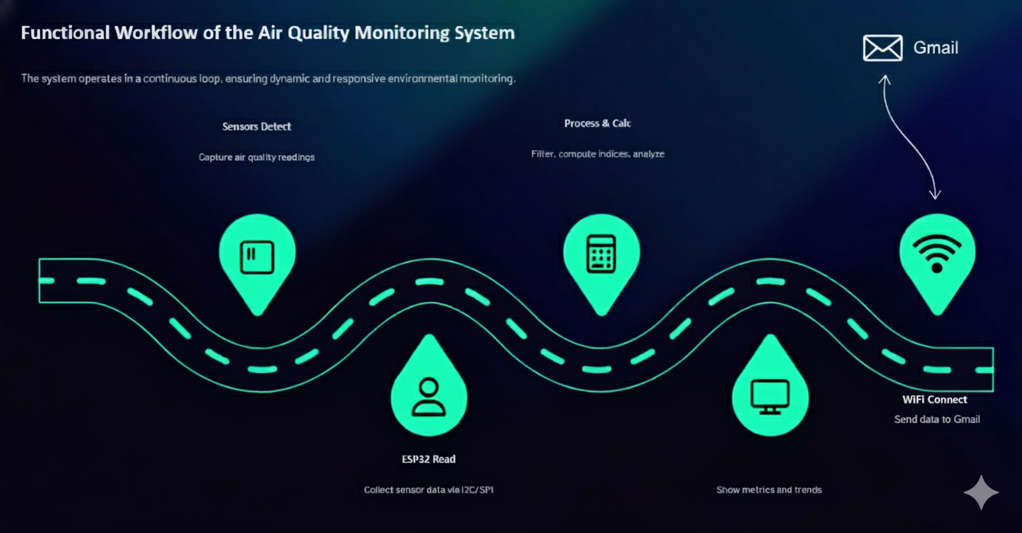


.
.
Further integration allows for wireless data logging or automated alerts when critical thresholds are exceeded.

Slide 11










Conclusion: Smart, Real-Time Air Quality Monitoring
This sensor-based system provides a cost-effective and powerful platform for comprehensive environmental sensing, supporting healthier living and working spaces.
Real-Time Performance
Comprehensive Insight
ESP32 ensures rapid data processing and immediate visualisation on the OLED.
Multiple sensors ensure a complete picture of air quality, humidity, and temperature.
Cost-Effective
Utilises affordable, readily available components for wide deployment.
IoT Ready
The ESP32 foundation supports future integration with cloud monitoring services.
Health Focus
Enables timely action based on detection of particulate matter and harmful gases.

